Slide 1
CS 331
Structures
MD Romael Haque

Slide 2
Structures
C++ allows a set of variables to be combined together into a single unit called a structure.
A structure is a programmer-defined data type that can hold many different data values.
In the past, before the use of object-oriented programming became common, programmers typically used these to group logically connected data together into a single unit.
Once a structure type is declared and its data members are identified, multiple variables of this type can be created, just as multiple objects can be created for the same class

Slide 3
Structures
Although structures are less commonly used today, it is important that you know what they are and how to use them.
Not only may you encounter them in older programs, but there are actually some instances in which classes will not work and structures must be used.

Slide 4
Structures
The way a structure is declared is similar to the way a class is declared, with the following differences:
The key word struct is used instead of the key word class.
Although structures can include member functions, they rarely do. So normally a structure declaration only declares member variables.
Structure declarations normally do not include the access specifiers public or private.
Unlike class members, which are private by default, members of a structure default to being public. Programmers normally want them to remain public and simply use the default.

Slide 5
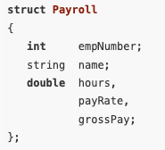
Example
Just as a class declaration is not instantiated until objects of the class are created, a structure declaration does not create any instances of the structure.
The structure declaration in our example simply tells the compiler what a Payroll structure looks like. It in essence creates a new data type named Payroll.

Slide 6
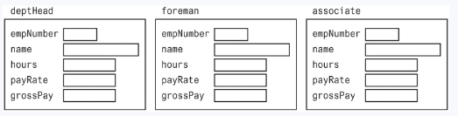
Structures
You define variables that are Payroll structures the way you define any variable, by first listing the data type and then the variable name.
The following definition creates three variables that are Payroll structures.
Payroll deptHead, foreman, associate;

Slide 7
Accessing Structure Members
Members of a structure are accessed just like public members of a class, with the dot operator.
However, the data members of a class are normally private and must be accessed through functions.
Because structure data members are public, they are accessed directly and can be used like regular variables.

Slide 8
Accessing Structure Members
The following statements assign values to the empNumber member of each of the Payroll variables we created.
deptHead.empNumber = 475;
foreman.empNumber = 897;
associate.empNumber = 729;
The following statements display the contents of all the deptHead’s members.
cout << deptHead.empNumber << endl;
cout << deptHead.name << endl;
cout << deptHead.hours << endl;
cout << deptHead.payRate << endl;
cout << deptHead.grossPay << endl;

Slide 9
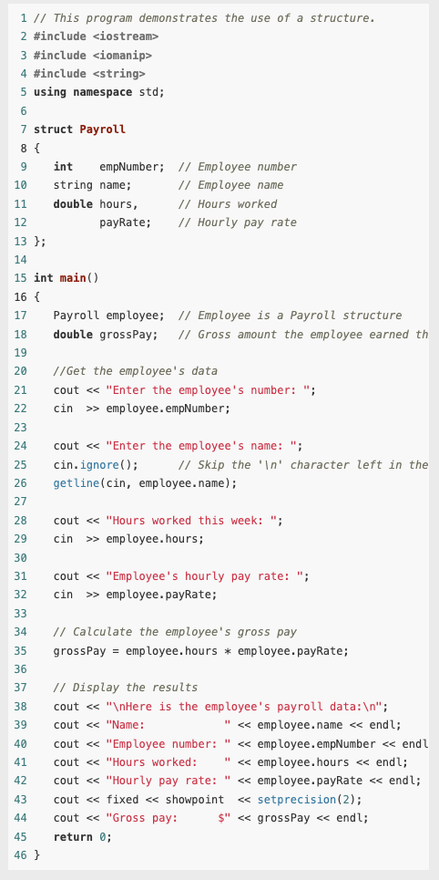
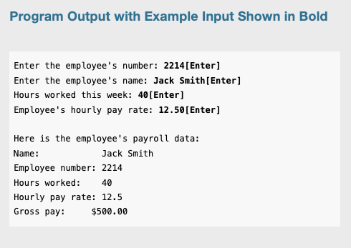
Example

Slide 10
Displaying and Comparing Structure Variables
In previous example each member of the employee structure variable was displayed separately.
This is necessary because the entire contents of a structure variable cannot be displayed by simply passing the whole variable to cout.
For example, the following statement will not work.
cout << employee << endl; //Error!

Slide 11
Displaying and Comparing Structure Variables
Likewise, although it is possible to compare the contents of two individual structure members, you cannot perform comparison operations on entire structures.
For example, if employee1 and employee2 are both Payroll structure variables, this comparison will cause an error.
if (employee1 == employee2) // Error!
The following comparison, however, is perfectly legal.
if (employee1.hours == employee2.hours) // Legal

Slide 12
Initializing a Structure
There are two ways a structure variable can be initialized when it is defined: with an initialization list or with a constructor.
The simplest way to initialize the members of a structure variable is to use an initialization list.
An initialization list is a list of values used to initialize a set of memory locations.
The items in the list are separated by commas and surrounded by braces.

Slide 13
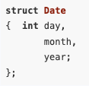
Initializing a Structure
For example, the following Date structure has been declared:
A Date variable can now be defined and initialized by following the variable name with the assignment operator and an initialization list, as shown here: Date birthday = {23, 8, 1983};

Slide 14
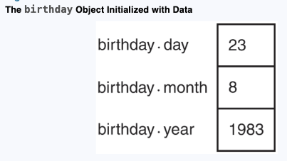
Initializing a Structure
This statement defines birthday to be a variable which is a Date structure.
The values inside the curly braces are assigned to its members in order.

Slide 15
Initializing a Structure
It is also possible to initialize just some of the members of a structure variable.
For example, if we know the birthday to be stored is August 23 but do not know the year, the variable could be defined and initialized like this:
Date birthday = {23, 8};
Only the day and month members are initialized here. The year member is not initialized.

Slide 16
Initializing a Structure
If you leave a structure member uninitialized, however, you must leave all the members that follow it uninitialized as well.
C++ does not provide a way to skip members when using an initialization list.
The following statement attempts to skip the initialization of the month member. It is not legal.
Date birthday = {23, , 1983}; // Illegal!

Slide 17
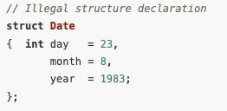
Initializing a Structure
It is important to note that you cannot initialize a structure member in the declaration of the structure because the structure declaration just creates a new data type.
No variables of this type exist yet.
For example, the following declaration is illegal:

Slide 18
Initializing a Structure
Because a structure declaration only declares what a structure “looks like,” the member variables are not created in memory until the structure is instantiated by defining a variable of that structure type. Until then, there is no place to store an initial value.
Although an initialization list is easy to use, it has two drawbacks:
It does not allow you to leave some members uninitialized and still initialize others that follow.
It will not work on many compilers if the structure includes any objects, such as strings.
In these cases, you can initialize structure member variables the same way you initialize class member variables - by using a constructor.

Slide 19
Initializing a Structure
As with a class constructor, a constructor for a structure must be a public member function with the same name as the structure and no return type.
Because all structure members are public by default, however, the key word public does not need to be used.

Slide 20
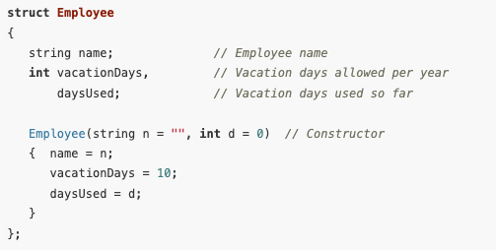
Initializing a Structure
Here is a structure declaration for a structure named Employee. It includes a two-argument constructor that provides default values in case an Employee variable is created without passing any arguments to the constructor.

Slide 21
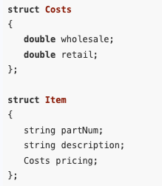
Nested Structures
Just as objects of one class can be nested within another class, instances of one structure can be nested within another structure. For example, consider the following declarations:

Slide 22
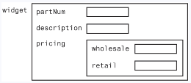
Nested Structures
The Costs structure has two double members, wholesale and retail.
The Item structure has three members.
The first two, partNum and description, are string objects.
The third, pricing, is a nested Costs structure.
If widget is defined to be an Item structure

Slide 23

Nested Structures
Widget can be accessed as follows:
widget.partnum = "123A";
widget.description = "iron widget";
widget.pricing.wholesale = 100.0;
widget.pricing.retail = 150.0;
Notice that wholesale and retail are not members of widget; pricing is.
To access wholesale and retail, widget’s pricing member must first be accessed and then, because it is a Costs structure, its wholesale and retail members can be accessed.
Notice also, as with all structures, it is the member name, not the structure name, that must be used in accessing a member. The following statements would not be legal

Slide 24
Nested Structures
When you are deciding whether or not to use nested structures, think about how various members are related.
A structure bundles together items that logically belong together.
Normally the members of a structure are attributes describing some object.
In our example, the object was a widget, and its part number, description, and wholesale and retail prices were its attributes.
When some of the attributes are related and form a logical subgroup of the object’s attributes, it makes sense to bundle them together and use a nested structure.

Slide 25
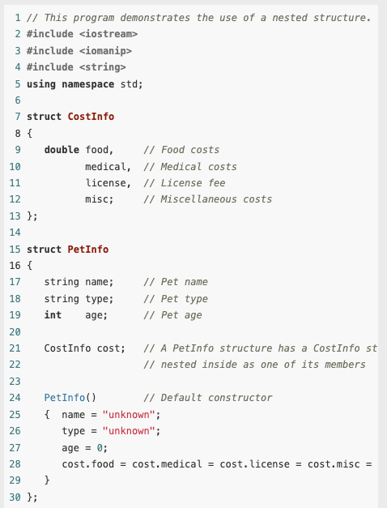
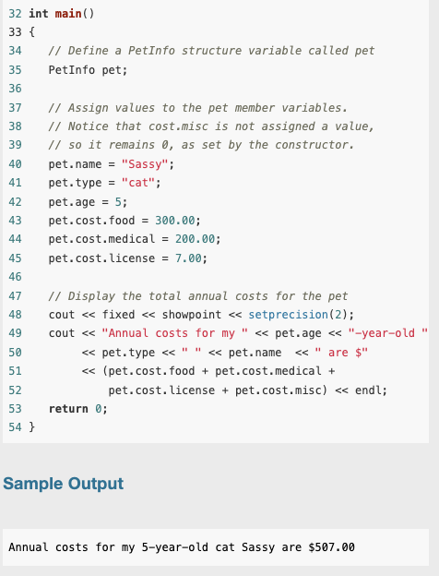
Example

Slide 26
Passing Structures to Functions
Structure variables, just like class objects, can be passed to functions by value, by reference, and by constant reference.
By default, they are passed by value.
This means that a copy of the entire original structure is made and passed to the function.
Because it is not desirable to take the time to copy an entire structure, unless it is quite small, structures are normally passed to functions by reference.
This, however, gives the function access to the member variables of the original structure, allowing it to change them.
If you do not want a function to change any member variable values, the structure variable should be passed to it as a constant reference.

Slide 27
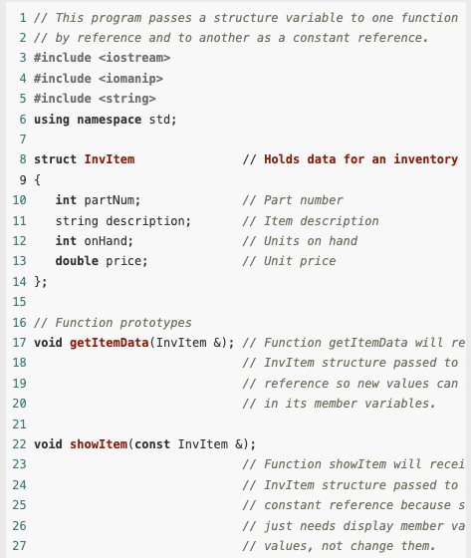
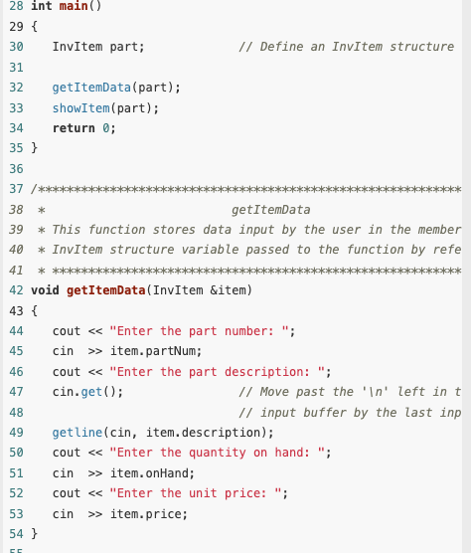
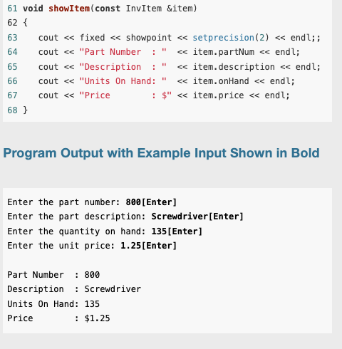
Example

Slide 28
Returning a Structure from a Function
A structure variable can also be returned from a function. In this case the return type of the function is the name of the structure.
In the previous example, it could have been written to allow
the getItemData function to create a local instance of an InvItem structure,
place data values into its member variables, and then pass it back to main, instead of receiving it from main as a reference variable.

Slide 29
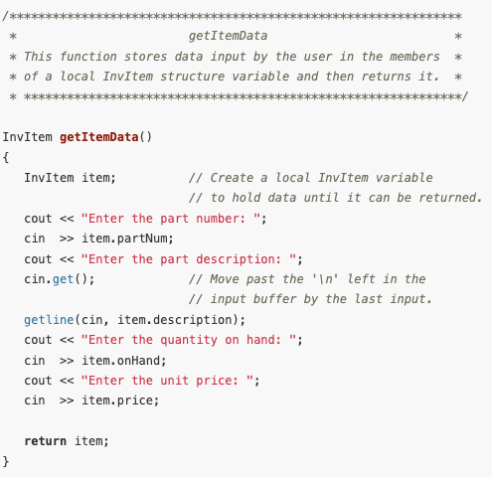
Returning a Structure from a Function
This is what the revised getItemData function would look like.
We can just call it in the main.
part = getItemData();

Slide 30
Enumerated Data Types
An enumerated data type in C++ is a programmer-defined data type whose legal values are a set of named integer constants.
So far we have used data types that are built into the C++ language, such as int and double, and object types, like string, which are provided by C++ classes.
However, C++ also allows programmers to create their own data types.

Slide 31
Enumerated Data Types
An enumerated data type is a programmer-defined data type whose only legal values are those associated with a set of named integer constants.
It is called an enumerated type because the named constants are enumerated, or listed, as part of the definition of the data type.
Here is an example of an enumerated-type declaration.
enum Roster { Tom, Sharon, Bill, Teresa, John };
This creates a data type named Roster.

Slide 32
Enumerated Data Types
Because the word enum is a C++ key word, it must be in lowercase.
However, notice that the data type name itself begins with a capital letter. Although this is not required, most programmers do capitalize this name.
The named integer constants associated with the Roster data type are called enumerators.
A variable of the Roster data type may only have one of the values associated with these enumerators. But what are their values?
By default, the compiler sets the first enumerator to 0, the next one to 1, and so on.
In our example then, the value of Tom would be 0, the value of Sharon would be 1, and so forth. The final enumerator, John, would have the value 4. Later in this section you will learn how to associate different values with these named constants if you wish.

Slide 33
Enumerated Data Types
It is important to realize that the example enum statement does not actually create any variables. It just defines the data type.
It says that when we later create variables of this data type, this is what they will look like - integers whose values are limited to the integers associated with the symbolic names in the enumerated set.
The following statement shows how a variable of the Roster data type would be defined.
Roster student;

Slide 34
Enumerated Data Types
The form of this statement is like any other variable definition: first the data type name, then the variable name.
Notice that the data type name is Roster, not enum Roster.
Now that the student variable has been created, it can be assigned a value, like this:
student = Sharon;
The value of the variable could then be tested like this:
if (student == Sharon)
Notice in these two examples that there are no quotation marks around Sharon because it is a named constant, not a string literal.

Slide 35
Enumerated Data Types
Even though the values in an enumerated data type are actually stored as integers, you cannot always substitute the integer value for the symbolic name.
For example, we could not have assigned Sharon as the value of student like this:
student = 1; // Error!
You can, however, test an enumerated variable by using an integer value instead of a symbolic name. For example, because Bill is stored as 2, the following two if statements are equivalent.
if (student == Bill)
if (student == 2)

Slide 36
Enumerated Data Types
You can also use relational operators to compare two enumerated variables.
For example, the following if statement determines if the value stored in student1 is less than the value stored in student2:
if (student1 < student2)
If student1 equals Bill, which is stored as 2, and student2 equals John, which is stored as 4, this statement would be true. However, if student1 equals Bill and student2 equals Sharon, which is stored as 1, the statement would be false.

Slide 37
Enumerated Data Types
As mentioned earlier, the symbols in the enumeration list are assigned the integer values 0, 1, 2, and so forth by default. If this is not appropriate, you can specify the values to be assigned, as in the following example.
enum Department { factory = 1, sales = 2, warehouse = 4 };
Remember that if you do assign values to the enumerated symbols, they must be integers. The following value assignments would produce an error.
enum Department { factory = 1.0, sales = 2.0, warehouse = 4.0 }; // Error!

Slide 38
Enumerated Data Types
Although there is no requirement that assigned integer values be placed in ascending order, it is generally considered a good idea to do so.
If you leave out the value assignment for one or more of the symbols, they will be assigned default values, as illustrated by the following two examples.
enum Colors { red, orange, yellow = 9, green, blue };
In this example, the named constant red will be assigned the value 0, orange will be 1, yellow will be 9, green will be 10, and blue will be 11.
enum Rooms { livingroom = 1, den, bedroom, kitchen };
In this example, livingroom will be assigned the value 1, den will be 2, bedroom will be 3, and kitchen will be 4.

Slide 39
Enumerated Data Types
One purpose of an enumerated data type is that the symbolic names help to make a program self-documenting.
However, because these names are not strings, they are for use inside the program only.
Using the Roster data type defined at the beginning of this section, the following two statements would output a 2, not the name Sharon.
Roster topStudent = Sharon;
cout << topStudent;
Because the symbolic names of an enumerated data type are associated with integer values, they may be used in a switch statement. Let’s look at an example -

Slide 40
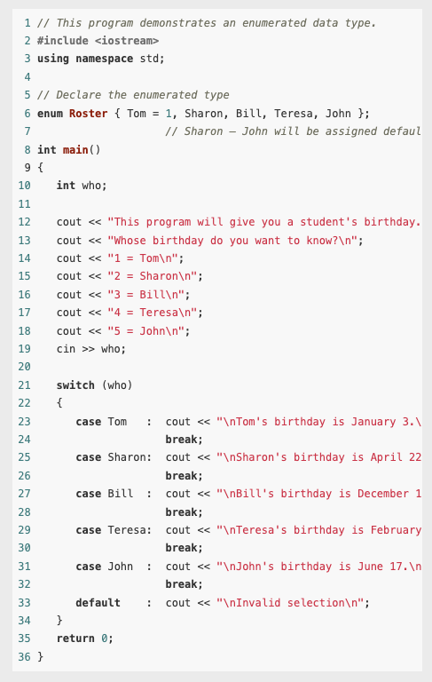
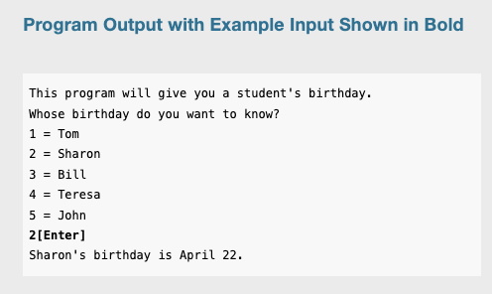
Example

Slide 41
Declaring an enum Data Type and Defining Variables All in One Statement
The following code uses two lines to declare an enumerated data type and define a variable of the type.
enum Car { PORSCHE, FERRARI, JAGUAR };
Car sportsCar;
However, C++ allows you to declare an enumerated data type and define one or more variables of the type in the same statement. So the previous code could be written like this:
enum Car { PORSCHE, FERRARI, JAGUAR } sportsCar;
The following statement declares the Car data type and defines two variables, myCar and yourCar.
enum Car { PORSCHE, FERRARI, JAGUAR } myCar, yourCar;

Slide 42
Assigning an Integer to an enum Variable
Even though the enumerators of an enumerated data type are stored in memory as integers, you cannot directly assign an integer value to an enum variable.
enum Day { MONDAY, TUESDAY, WEDNESDAY, THURSDAY, FRIDAY }; Day today;
We could now write the following assignment statement:
today = THURSDAY;
But the following statement is illegal and will produce an error message if you try to compile it.
today = 3; // Error!

Slide 43
Assigning an Integer to an enum Variable
When assigning a value to an enum variable, you should use a valid enumerator.
However, if circumstances require that you store an integer value in an enum variable, you can do so by casting the integer to the enum data type. Here is an example:
today = static_cast<Day>(3);
This statement will produce the same results as:
today = THURSDAY;

Slide 44
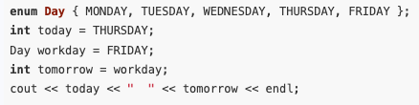
Assigning an Enumerator to an int Variable
Although you cannot directly assign an integer value to an enum variable, you can directly assign an enumerator to an integer variable.
For example, the following code will work just fine.
When this code runs it will display 3 4.

Slide 45

Using Math Operators to Change the Value of an enum Variable
Even though enumerators are really integers and enum variables really hold integer values, you can run into problems when trying to perform math operations with them.
For example, look at the following code.
The third statement causes a problem because the expression day1 + 1 results in the integer value 2. The assignment operator then attempts to assign the integer value 2 to the enum variable day2. Because C++ cannot implicitly convert an int to a Day, as previously discussed, an error occurs.

Slide 46
Using Math Operators to Change the Value of an enum Variable
We can fix this by using a cast as we did above to explicitly convert the result to the Day data type, as shown here:
day2 = static_cast<Day>(day1 + 1); // This works

Slide 47
Using Enumerators to Output Values
As we have already seen, sending an enumerator to cout causes the enumerator’s integer value to be displayed.
For example, assuming we are using the Day type previously described, the following statement displays 0.
cout << MONDAY << endl;

Slide 48
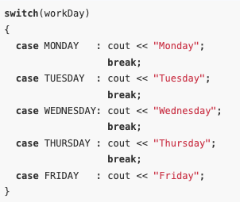
Using Enumerators to Output Values
If we wish to use the enumerator to display a string such as “Monday,” we’ll have to write code that produces the desired string.
For example, if workDay is a Day variable that has been initialized to some value, the following switch statement displays the name of a day, based on the value of the variable.

Slide 49
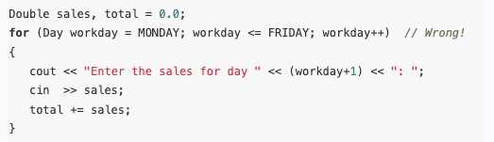
Using Enumerators to Control a Loop
Because enumerators are stored in memory as integers, we can use them to control how many iterations a loop should perform.
However, as discussed, we cannot assign the result of a math operation to an enumerator without first casting the result to its enum data type.
Therefore, we cannot use the ++ or –– operators directly on an enum variable. These code will not work.

Slide 50

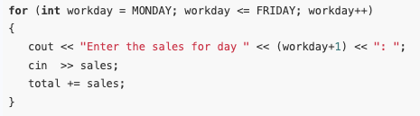
Using Enumerators to Control a Loop
We can solve the problem by changing the for statement to the following:
However, it is simpler to make the loop control variable an int. Then you can write the loop like this:

